Slide 1

COMPUTER-AIDED SOFTWARE ENGINEERING
Prepared under the guidance of-
Dr. Shaligram Prajapat sir
Presented & prepared by-
Anushka Saxena

Slide 2
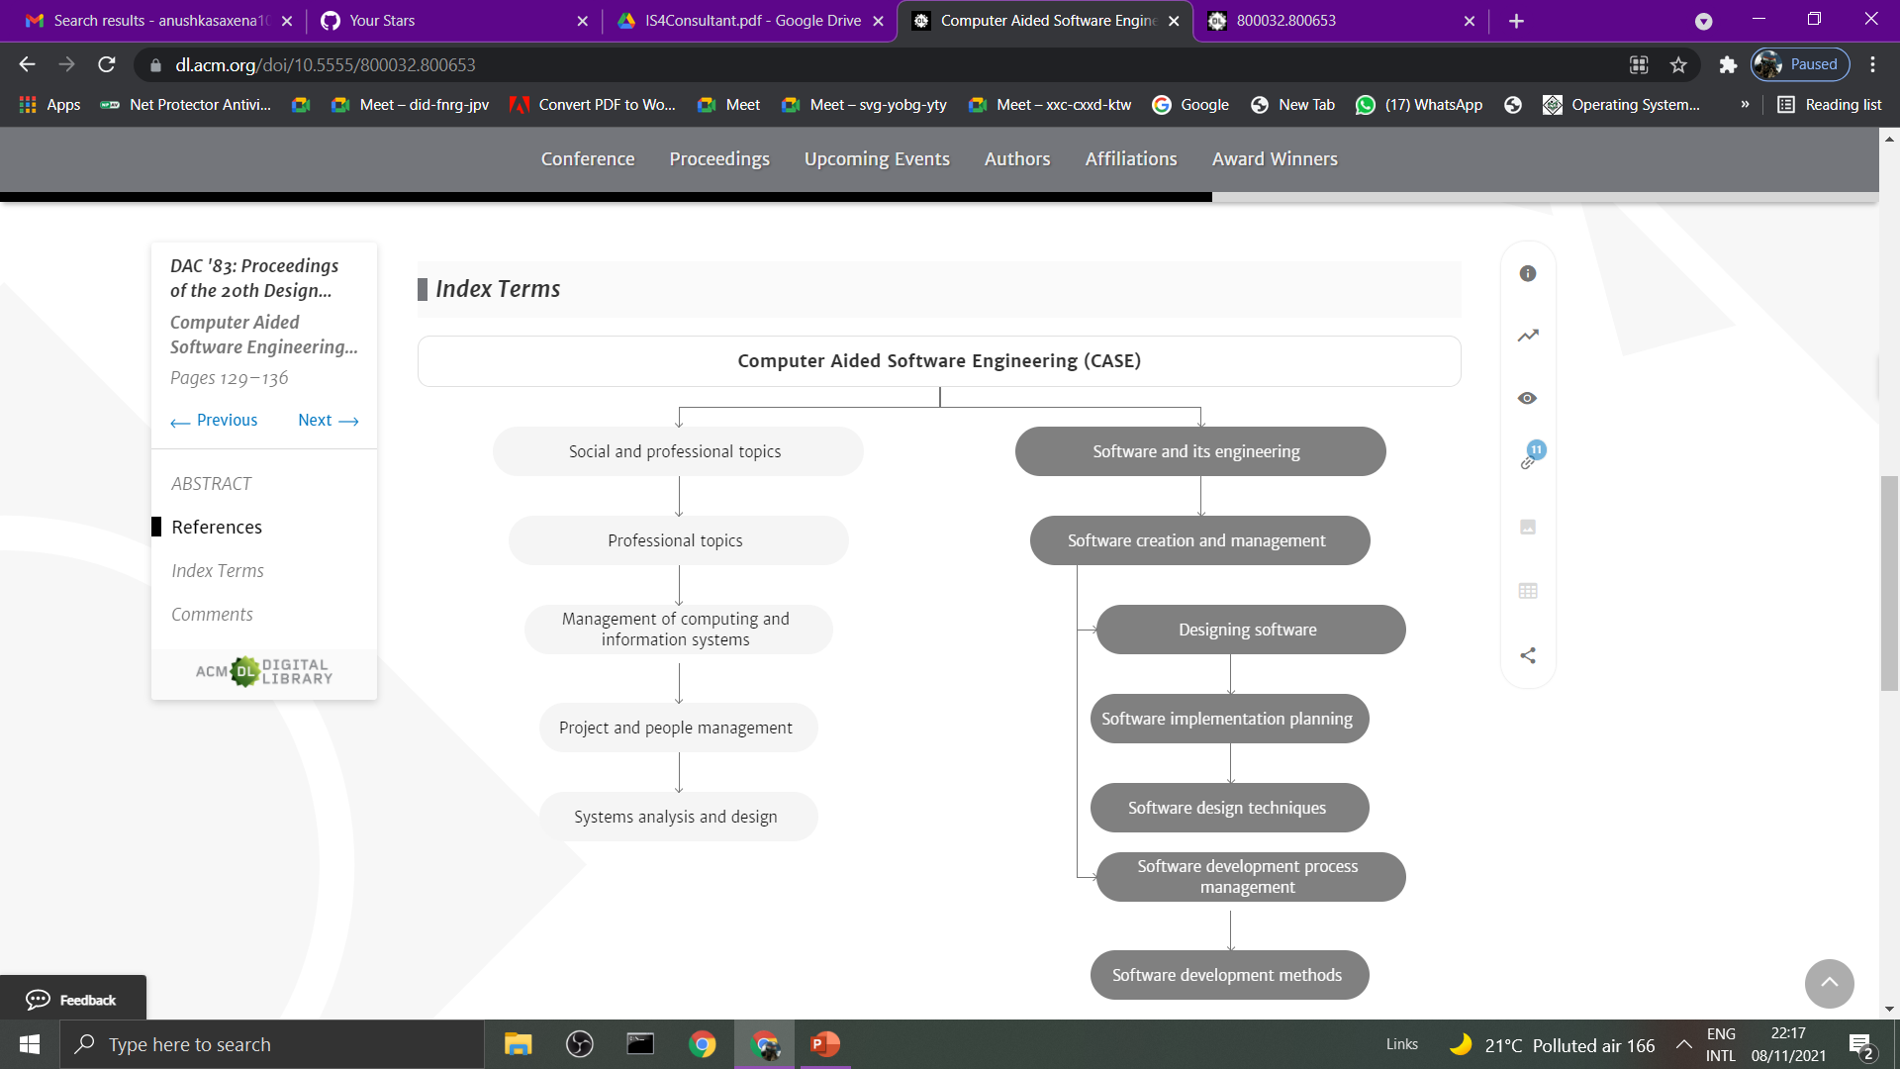

Slide 3
Presentation Outline
Definition
Purpose
CASE Architecture
CASE tools
Repository
Workbenches & Object-oriented CASE tools
CASE Environment
SWOT analysis of CASE
References

Slide 4
What is CASE?
Computer Aided Software Engineering (CASE) can be broadly defined as a set of automated tools that assist in the entire software engineering process to improve productivity during the development process and the quality of the resulting system.
It is the implementation of computer facilitated tools and methods in software development to ensure a high-quality and defect-free software.

Slide 5
Purpose of CASE
Support the notation conventions of a specific development method and enforce the method’s rules.
Support teams of analysts and designers working together on a project.
Allow the user to navigate freely between different models.
Support maintenance of traceability and configuration management information to help management control the development process.
Support testing to ensure that a model is consistent with the real-world problem it represents.

Slide 6
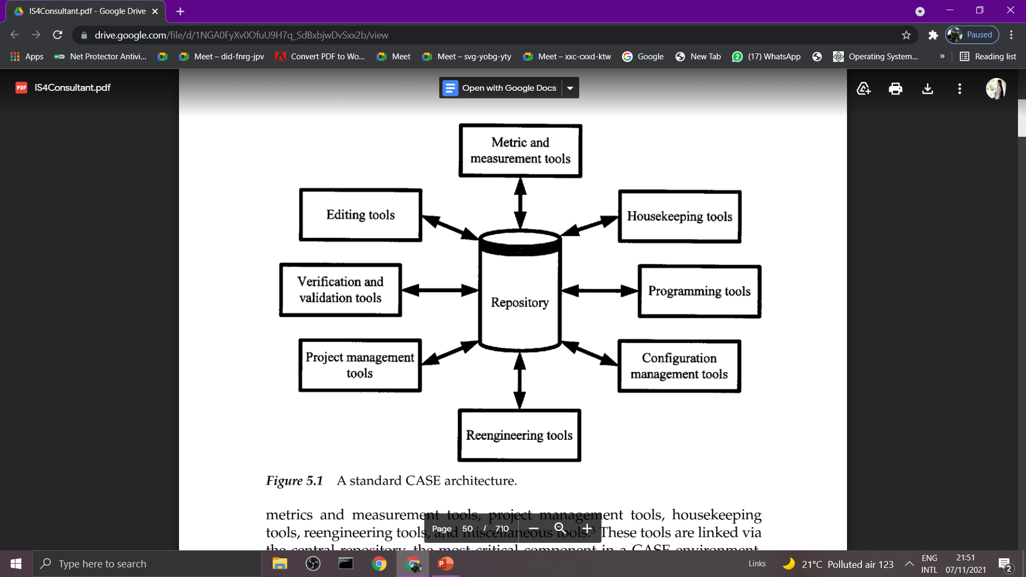
CASE architecture

Slide 7
CASE tools
Editing tools
Programming tool
Verification and validation tools
Configuration management tools
Metrics and measurement tools
Project management tools
Housekeeping tools
Reengineering tools
Miscellaneous tools

Slide 8
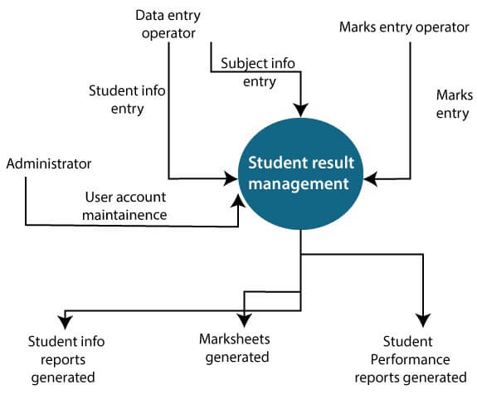
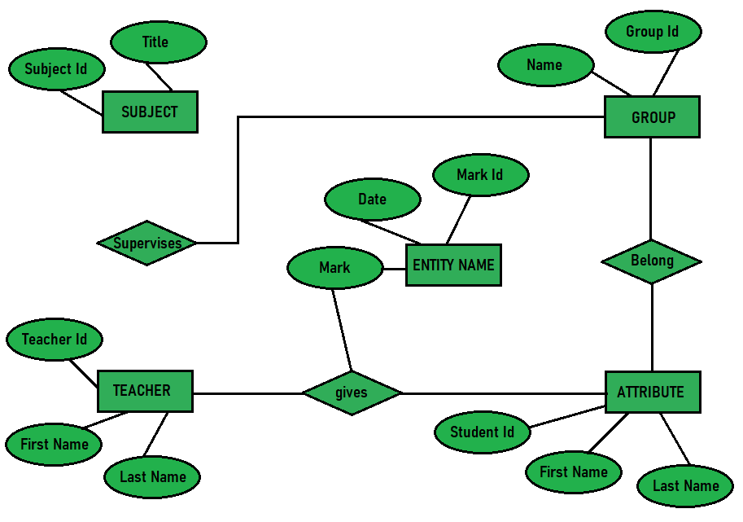
Editing tools
Editing tools include traditional tools (such as word-processing and programming editors) that help in creating documentation and diagramming tools that provide graphical capabilities.
Data flow diagram
Entity-relationship diagram

Slide 9
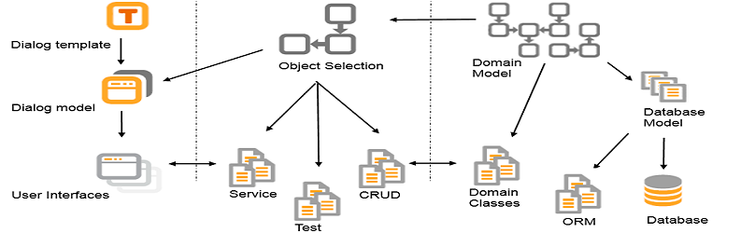
Programming tools
Coding and debugging tools are the standard tools used to compile (or interpret), run, and debug a program.
Code generators are tools that write code from a high-level specification of an application.
Restructuring tools help in analyzing and reformatting existing code by removing unnecessary go-to statements or other unreachable portions of code.

Slide 10
Verification and validation tools
Verifiers ensure that the syntax is correct
Validation tools ensure that the requirements are correct and the product functions are the functions desired or requested by the customer.
Static analyzers generate cross-references, check for syntax, and enforce standards on a program without executing the code.
Dynamic analyzers, such as tracers and profilers, monitor program execution.
Comparators check for differences or similarities between files; they are used for checking test output and expected program results.

Slide 11
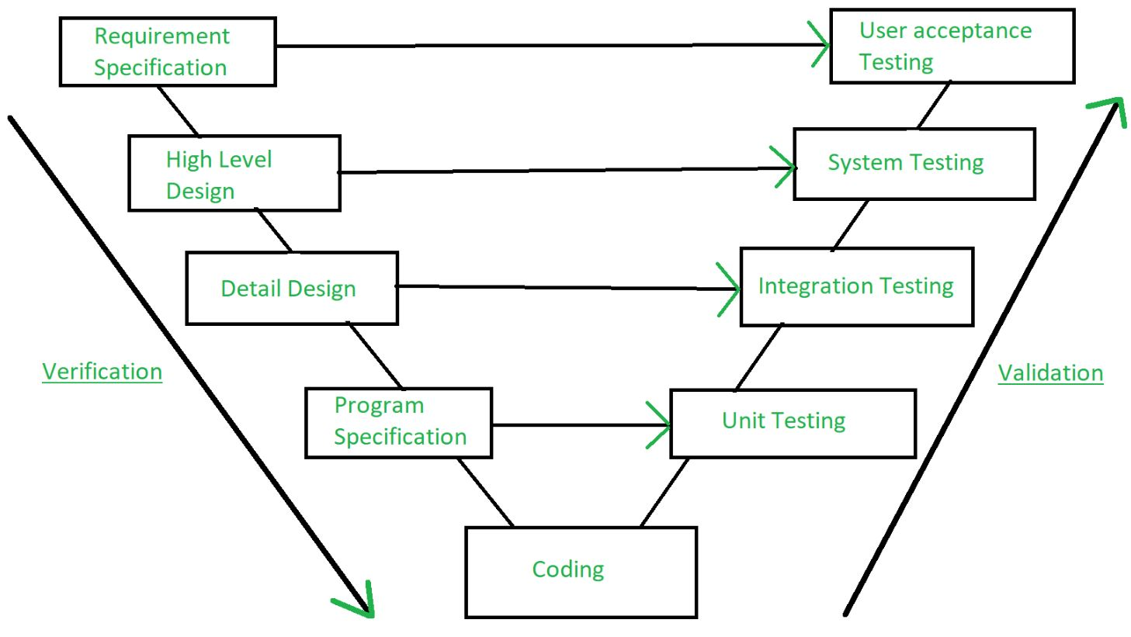

Slide 12
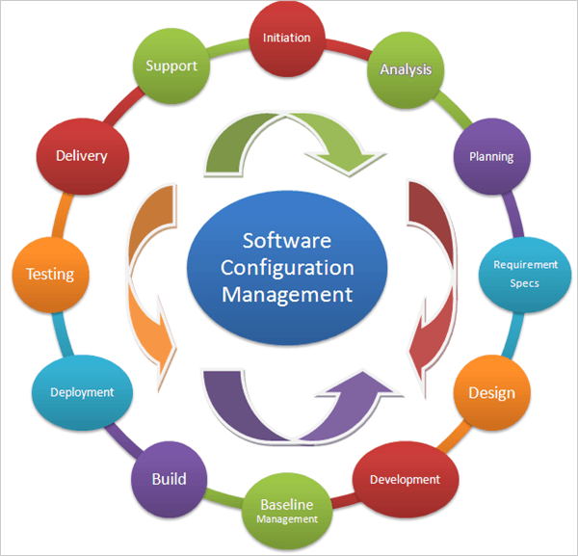
Configuration management tools
Configuration management tools help coordinate and manage software development.
Version management tools help maintain the various versions of code and ensure that the correct copy of the code is incorporated in subsequent work.
Configuration builders ensure that the correct version of each component or piece of software is included in the finished product.

Slide 13
Project estimation and management
CASE provides modules that can help in the estimation process.
Typical project management tools enable managers to create and use detailed work plans for resource allocation, identify and track task dependency relationships, implement project tracking, maintain charge-back allocations, and create PERT and Gantt charts.
A third sub-class of project management tools (email, bulletin boards, shared whiteboards) supports group work and may include tools to record various decisions taken during the system development process.

Slide 14
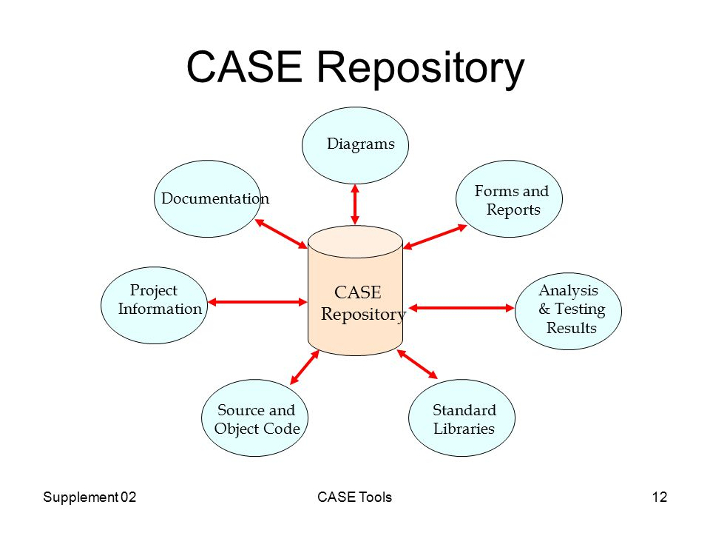
The Repository
The repository is a holding area for storing and integrating diagrams, descriptions, specifications, test data, and other items relevant to the development process.
The repository maintains information about the interrelationships between the various (logical and physical) models.
Typically a separate repository is maintained for each project and a central repository maintains the details for all projects.

Slide 15
Workbenches & Object-oriented CASE tools
CASE workbenches is a set of tools which supports a particular phase in the software process
Tools work together to provide comprehensive support. Common services are provided which are used by all tools and some data integration is supported.
Object-oriented CASE tools support diagramming techniques for such basic object-oriented concepts as classes, inheritance, etc.
Object-oriented CASE tools must support consistency checks and provide error checking capabilities.

Slide 16
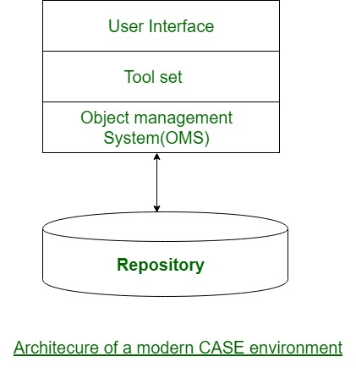
CASE environments
The term environment is reserved for the complete set of automated facilities required to support all the activities in the systems development life cycle, including facilities that allow users to switch easily from one activity to another.
An environment must support reusability of tool components, ease of tool integration, prototyping, and support for system development life cycle activities in big multi-user, multi-project software environments.
An environment must be extensible.

Slide 17
SWOT Analysis of CASE
Strengths-
The major benefit attributed to CASE is improved productivity as it significantly reduces development time.
Improved quality, generates highly maintainable code
Helps to enforce style conventions, validate syntax, perform consistency checks across models
Can be used to track the progress of a project and maintain traceability from analysis, through design and implementation.
Aids in managing the ripple effects that result from a change to a model.
Better documentation

Slide 18
SWOT Analysis of CASE
Weaknesses-
Some CASE tools are based on a specific methodology or do not support the modeling conventions required by a given project.Improved quality, generates highly maintainable code
Various studies have shown that CASE is often not used uniformly across the organization, is used by only one group, or is never used.
Unless the organization realigns its CASE technology goals with its business goals, the results are likely to be disappointing.
Opportunities-
Given proper training, if users perceive that CASE tools provide them a relative advantage they are likely to use them voluntarily.

Slide 19
REFERENCES
Class notes and pdf provided by Shaligram sir
William S. Devis & David C. Yen “The Information System Consultant’s Handbook”, CRC Press LLC, 1999.
https://drive.google.com/file/d/1NGA0FyXv0OfuU9H7q_SdBxbjwDvSxx2b/view
https://www.geeksforgeeks.org/computer-aided-software-engineering-case/
https://dl.acm.org/doi/pdf/10.5555/1074100.1074241
https://dl.acm.org/doi/10.5555/800032.800653
https://www.csm.ornl.gov/~sheldon/cs330/PDF/SLIDES/c26.1.pdf

